Slide 1


NIELIT CHANDIGARH May 29, 2025
https://www.w3schools.com/git/default.asp?remote=github

Slide 2



Today's Agenda
1
What is Git & GitHub?
2
Understanding GitHub Workflow
3
Practical session
Bonus + Wrap up
4

Slide 3
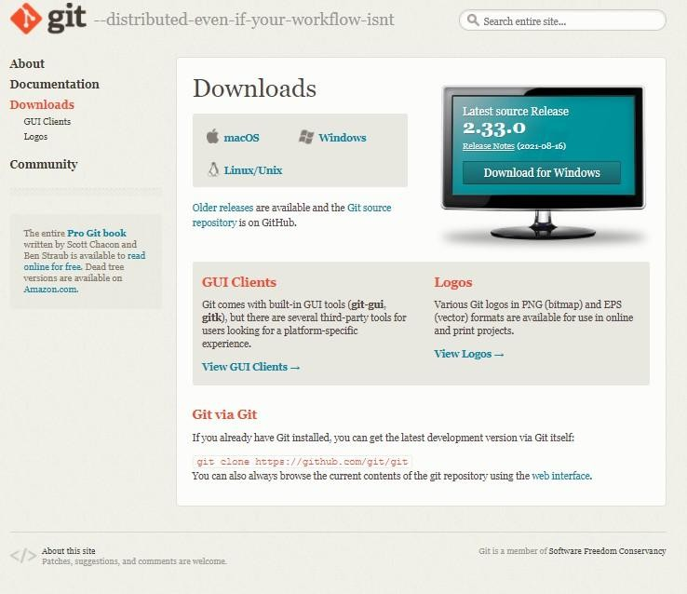
Prerequisite
https://git-scm.com/downloads
Git
Take: 5 minutes

Slide 4

Prerequisite
https://github.com/
GitHub Account
Take: 5 minutes

Slide 5
Git
GitHub
Host for Git Repositories
Version Control System
Save versions and Easily revert changes
The project is called a "Repository"
Store Repositories in the Cloud
Easily collaborate over the Internet

Slide 6
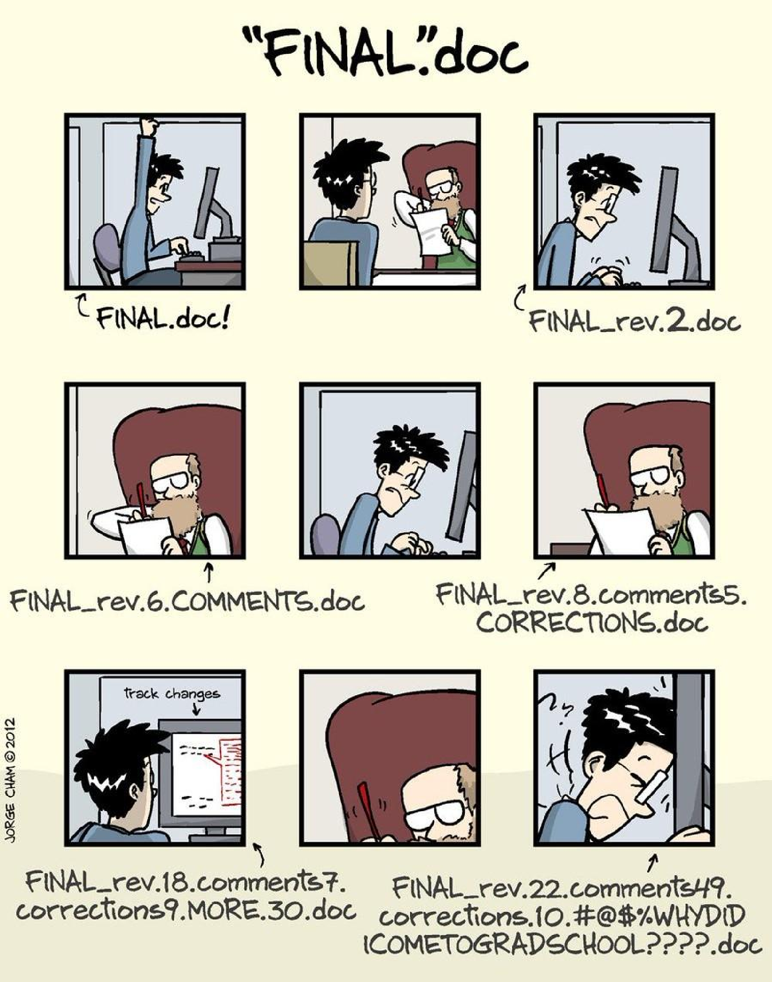
WHAT IS VERSION CONTROL AND
WHY USE IT?

Slide 7
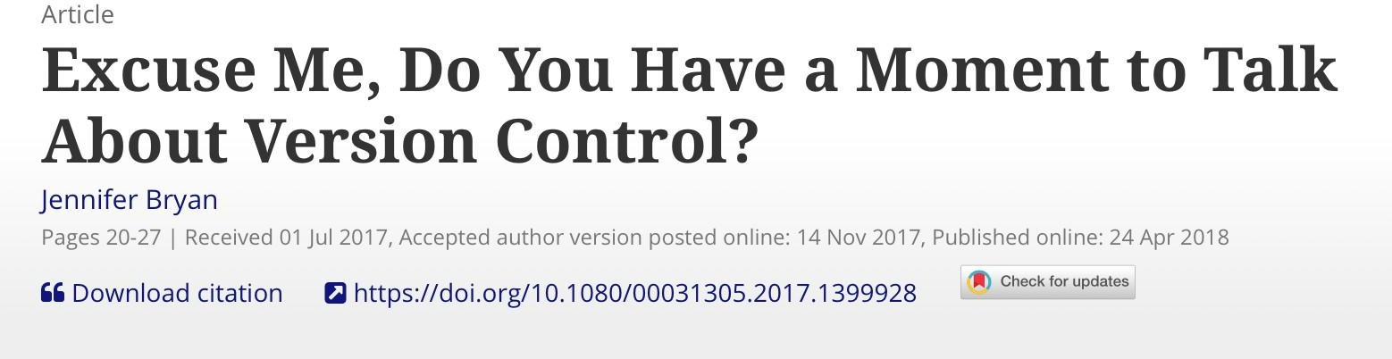
VERSION CONTROL
A system that manages and keeps records of changes made to files
Allows for collaborative development
Allows you to know who made what changes and when
Allows you to revert any changes and go back to a previous state

Slide 8
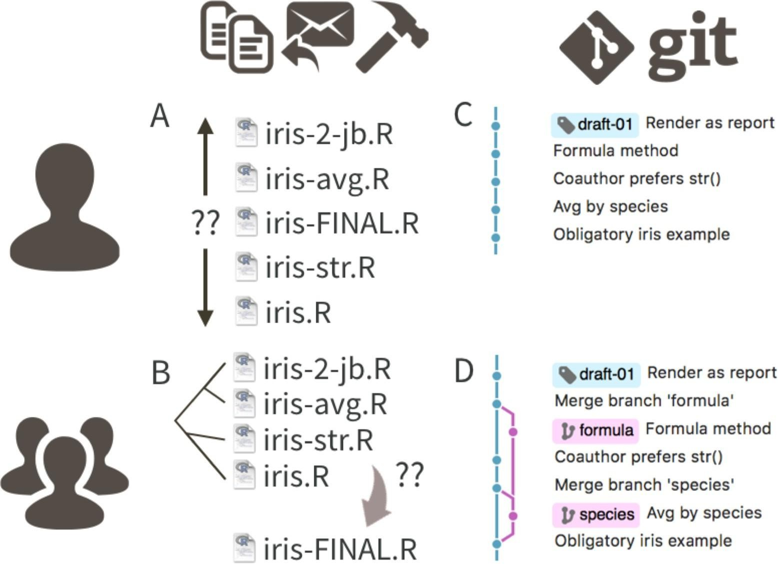

Slide 9


WHAT ARE GIT AND GITHUB?
GitHub is an online hub for hosting Git repositories and provides GUI software for using Git
GitHub complements Git by providing a slick user interface and distribution mechanism for repositories. Git is the software you will use locally to record changes to a set of files. GitHub is a hosting service that provides a Git-aware home for such projects on the internet
GitHub is like DropBox or Google Drive, but more structured, powerful, and programmatic
Git and GitHub are two different things
Git is a particular implementation of version control originally designed by Linus Torvalds in 2005 as a way of managing the Linux kernel. Git manages the evolution of a set of files – called a repository or repo
Essentially, the language of version control

Slide 10
What is Git?
Git is a distributed version control system
Tracks changes in source code during software development
Helps collaborate without overwriting each
other’s work

Slide 11
What is GitHub?
GitHub is a cloud-based hosting service for Git repositories
Allows collaboration, code sharing, pull requests, and issue tracking
Supports open-source (public) and private projects

Slide 12
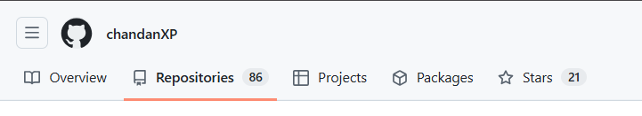

Set up your git hub Profile
Step 1: Create the Secret Repository
Log into your account and navigate to the GitHub New Repository Page.
In the Repository name field, type your exact GitHub username. You will see a banner confirming you found a secret!
Set the visibility settings strictly to Public.
Check the box that says Add a README file.
Click the green Create repository button at the bottom.

Slide 13
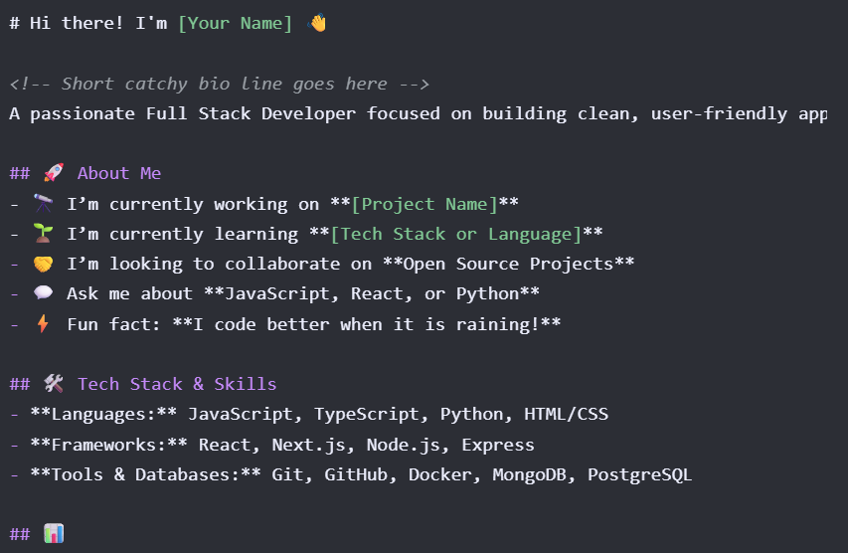
Step 2: Copy and Customize the Code
Open the README.md file in your new repository,
click the pencil icon to edit it, and paste the structured Markdown code template.
Step 3:
Save and Publish

Slide 14
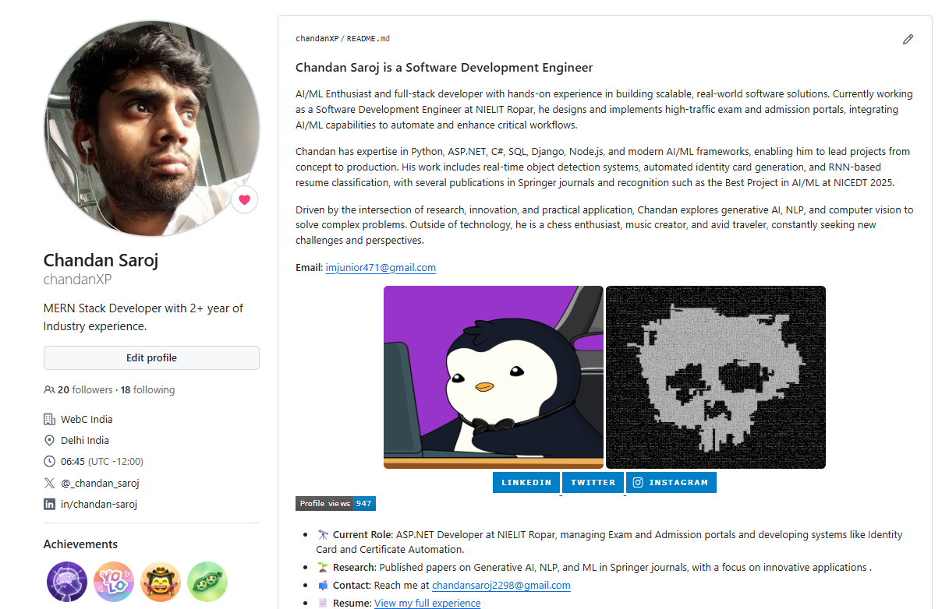
Step 3: Save and Publish
Once the file is saved, You cool README.md file content will be visible to your git hub Profile,
You can now beautify and add all of your project and achievements on your git hub front page
link of readme file code: https://github.com/chandanXP/chandanXP/blob/main/README.md

Slide 15
Creating my Webpage on internet for free
Step 1: Create a Dedicated Repository
Go to github.com.
Set the Repository name to your-username.github.io (replace your-username with your actual GitHub username).
Set the visibility to Public (required for free hosting).
Leave all other options unchecked and click Create repository.

Slide 16

Step 2: Write Your Webpage Code
<!DOCTYPE html>
<html lang="en">
<head>
<meta charset="UTF-8">
<meta name="viewport" content="width=device-width, initial-scale=1.0">
<title>My Personal Website</title>
<link rel="stylesheet" href="style.css">
</head>
<body>
<header>
<h1>Welcome to My Website</h1>
</header>
<main>
<p>This page is hosted completely free on !</p>
<button id="colorBtn">Click to Change Theme</button>
</main>
<script src="script.js"></script>
</body>
</html>
Inside your new repository,
click Add file > Create new file.
You will create three core files. Paste the following clean boilerplate code into them:
1. Name the first file index.html (Must be lowercase)

Slide 17
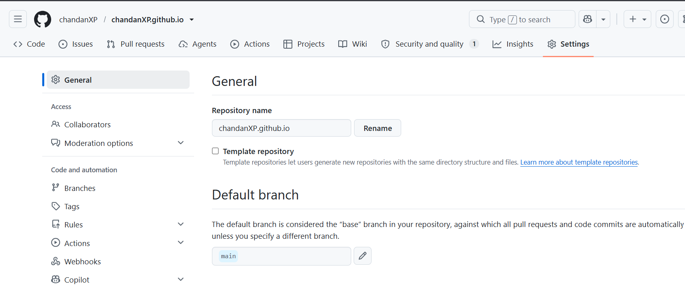
Step 3: Enable GitHub Pages
Click on the Settings tab (the gear icon) at the top of your repository page.

Slide 18
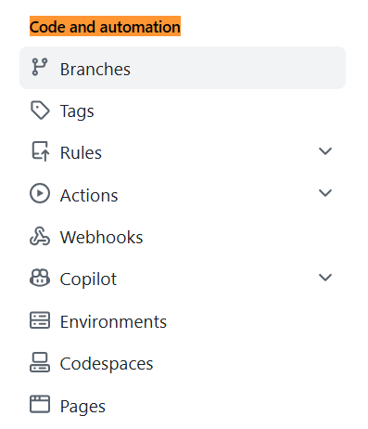

2. In the left-hand sidebar under the "Code and automation" section, click on Pages.

Slide 19
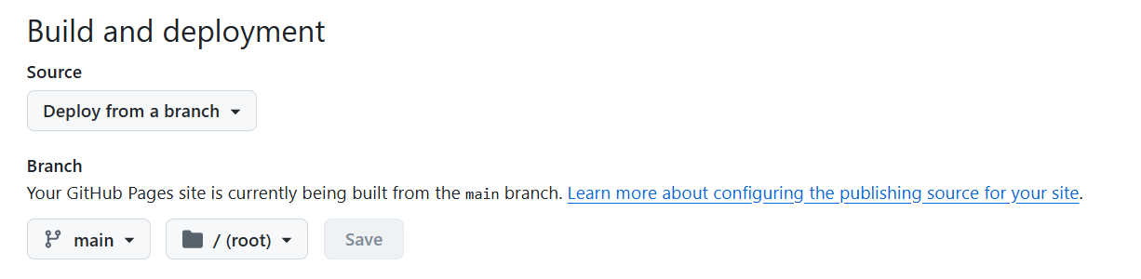
3. Under the Build and deployment section, look for the Source dropdown. Ensure it is set to Deploy from a branch.
4. Under Branch, change the dropdown from None to main (or master), leave the folder as / (root), and click Save.

Slide 20
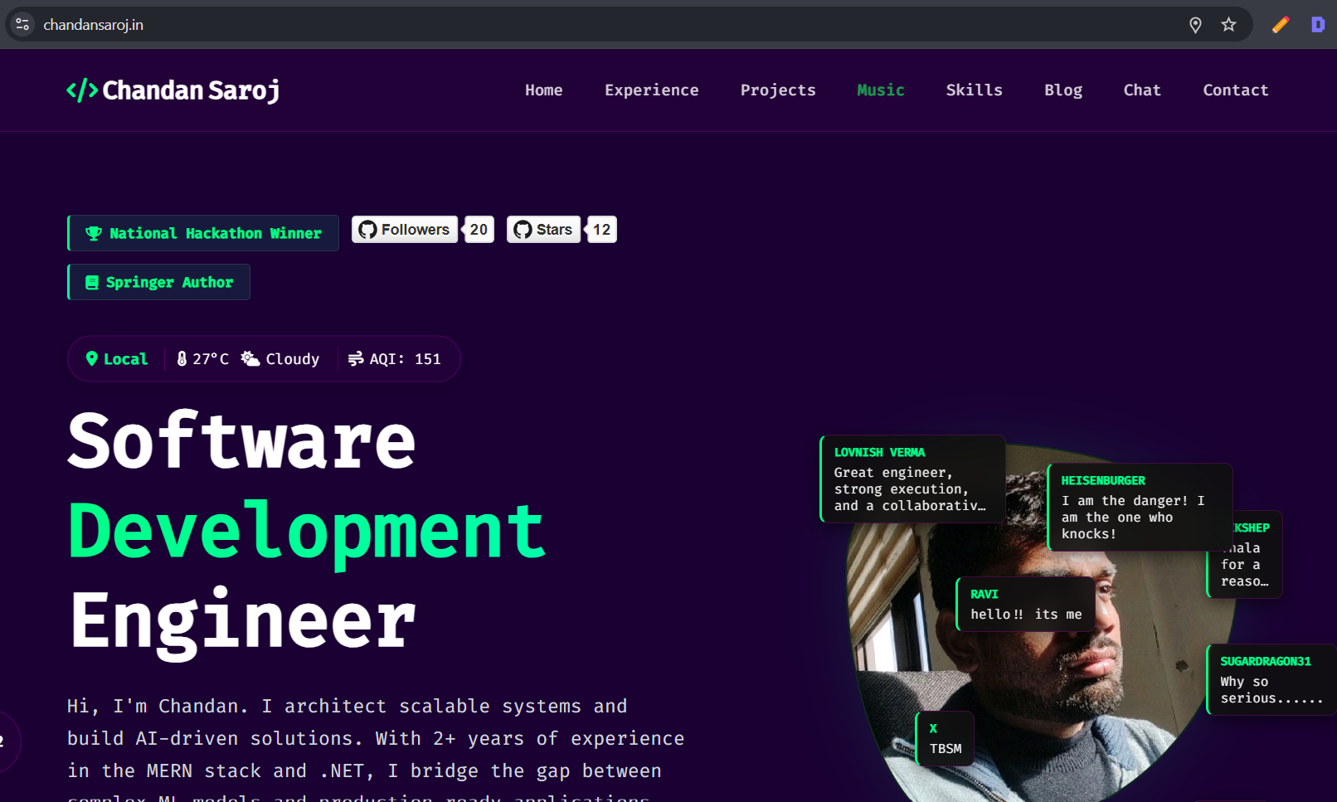
Congratulations you have hosted you own website on internet for free!!!
No localhost your website is live.
flex your website with your friends

Slide 21
1. Install Git from git-scm.com
Setting Up Git (Quick Setup)
2. Configure user info:
git config --global user.name "Your Name"
git config --global user.email "your.email@example.com"

Slide 22
Starting a Git Repository
Initialize a Git repo locally:
git init
Add files to staging area:
git add filename.txt
Commit files:
git commit -m "Initial commit"

Slide 23
Creating and Cloning a GitHub Repository
Create a repo on GitHub at github.com/new
Copy repo URL (HTTPS or SSH)
Clone to local machine:
git clone https://github.com/username/repo.git

Slide 24
Git Clone
What is git clone?
git clone is a command to create a local copy of an existing remote Git repository.
It downloads the entire repository — including all files, commits, branches, and history.
The cloned repo will automatically have the remote origin set to the URL you cloned from.
When to use git clone?
When you want to start working on an existing project hosted on GitHub (or any Git server).
Instead of creating a new repo, you copy an existing one to your local machine.
# Go to the folder where you want to clone the repo
cd projectfolder
# Clone the repo git clone
https://github.com/username/reponame.git
# Move into the cloned directory cd reponame
# Check remote git remote -v
Common next steps after cloning:
Pull latest changes (if needed):
git pull origin main
Make changes, then:
git add . git commit -m "Your commit message" git push origin main

Slide 25
Pushing Changes to GitHub
cd /path/to/your/project
git init
git add .
https://github.com/username/repo.git
git push -u origin master
Push Guide:
https://github.com/lovnishverma/lovnishverma/blob/main/push.md
git | commit | -m | "Initial | commit"
git | remote | add | origin

Slide 26
Pulling Changes from GitHub
Initialize repo (if new):
git init
Connect to remote:
git remote add origin https://github.com/username/repo.git
Pull from remote (to get the latest code if any):
git pull origin main
Make your changes
Add, commit, and push your changes
Important
If you cloned the repository directly from GitHub, e.g.:
git clone https://github.com/username/repo.git
then the remote is already connected and you don’t need to add remote manually.
Pull Guide: https://github.com/lovnishverma/lovnishverma/blob/main/pull.md

Slide 27

Branching Basics
Example Workflow:
# Create and switch to new branch git checkout -b feature-login
# Work, add, commit your changes here
# Switch back to main branch git checkout main
# Merge feature-login changes into main (optional)
git merge feature-login
Branch = separate line of development
Create a branch:
git checkout -b feature-branch Switch branches:
git checkout master
Command | Description
git branch <branch-name> | Create a new branch
git checkout <branch-name> | Switch to an existing branch
git checkout -b <branch-name> | Create and switch to a new branch
git branch | List all branches and show current branch

Slide 28

Making Changes in Branch
5. Commit your changes with a descriptive message
git commit -m "Add login feature with form validation"
1. Switch to the branch you want to work on
git checkout <branch-name>
3. Check the status to see changed files
git status
Shows which files have been modified, added, or deleted.
git push -u origin <branch-name>
Example:
Example:
Stage the changes for commit
Stage all changes:
git add .
Or stage specific files:
git add filename1 filename2
git push -u origin feature-login
git checkout feature-login
For subsequent pushes, simply:
7. Collaborate
Others can now pull your branch:
git pull origin <branch-name>
Or review your changes via Pull Requests on GitHub.
Make your changes in the files
Open files in your editor
Add or modify code, text, or resources
git push
Step | Command | Description
Switch to branch | git checkout <branch-name> | Work on desired branch
Check status | git status | See modified files
Stage changes | git add . or git add <files> | Prepare files for commit
Commit changes | git commit -m "message" | Save changes locally
Push branch (first time) | git push -u origin <branch- name> | Upload branch and commits
Push branch (after) | git push | Upload new commits

Slide 29
Merging Branches
What is merging?
Merging takes the changes from one branch (e.g., a feature branch) and integrates them into another branch (usually main or master).This lets you combine completed work into the main
codebase.
Typical Workflow for Merging
Switch to branch to merge into (e.g., master):
git checkout master
Update your current branch
Make sure it’s up to date with the remote repository:
git pull origin master
Merge the other branch into this branch Example: merge feature-login branch into master: git merge feature-login
Resolve any merge conflicts (if they occur)
Git will tell you which files have conflicts.
Open those files, look for conflict markers (<<<<<<,
======, >>>>>>).
Edit to keep desired code.
Stage the resolved files:
git add <file>
Then complete the merge commit:
git commit
5. Push the merged changes to remote
git push origin main

Slide 30
Resolving Merge Conflicts (Overview)
Sometimes changes conflict
Git will mark conflicting files
Open conflicted files and edit
After resolving:
git add conflicted-file.txt git commit
Guide:
https://github.com/lovnishverma/lovnishverma/blob/main/pull.md#step-5-resolve-merge-conflicts-if-any

Slide 31
Deleting a Branch
After merging, delete branch locally:
git branch -d feature-branch
# Delete local branch
Delete branch on remote:
git push origin --delete feature-branch
# Delete remote branch

Slide 32

Useful Git Commands Cheat Sheet
Command | Description
git status | Show current repo status
git log | View commit history
git branch | List branches
git checkout <branch> | Switch branches
git pull | Pull changes from remote
git push | Push commits to remote
git merge <branch> | Merge branch into current
git clone <url> | Clone remote repo

Slide 33
What is Git LFS?
Git LFS is an extension for Git to manage large files (e.g., images, videos, datasets) efficiently.
Instead of storing large files directly in the Git repository, it stores pointers to the files.
The actual large files are stored on a separate server or cloud storage.
Helps keep the Git repo lightweight and fast.
Basic Git LFS Workflow
# Install Git LFS (one-time) git lfs install
# Track large file types git lfs track "*.psd"
# Add files normally git add largefile.psd
# Commit and push as usual git commit -m "Add large file" git push origin main
Why Use Git LFS?
Avoid bloated repository size.
Faster cloning and fetching.
Better handling of binary files that don’t
diff well.
GIT LFS GUIDE:
https://github.com/lovnishverma/lovnishverma/blob/main/Git%20LFS%20(Large%20File%20Storage).md

Slide 34
Summary and Best Practices
Demo Time
# Initialize repo git init
Commit often with clear messages
Use branches for features and bug fixes
Pull frequently to avoid conflicts
Write meaningful commit messages
Always review changes before pushing
GitHub imposes a 100MB file size limit for files in a repository and recommends using Git LFS (Large File Storage) for files larger than 50MB.
# Create file and commit
echo "Hello GitHub" > README.md git add README.md
git commit -m "Add README"
# Connect remote repo
git remote add origin https://github.com/username/demo.git
# Push to GitHub
git push -u origin master
# Create and switch branch
git checkout -b feature-update
# Make changes and commit
echo "New feature" >> README.md git add README.md
git commit -m "Add new feature"

Slide 35
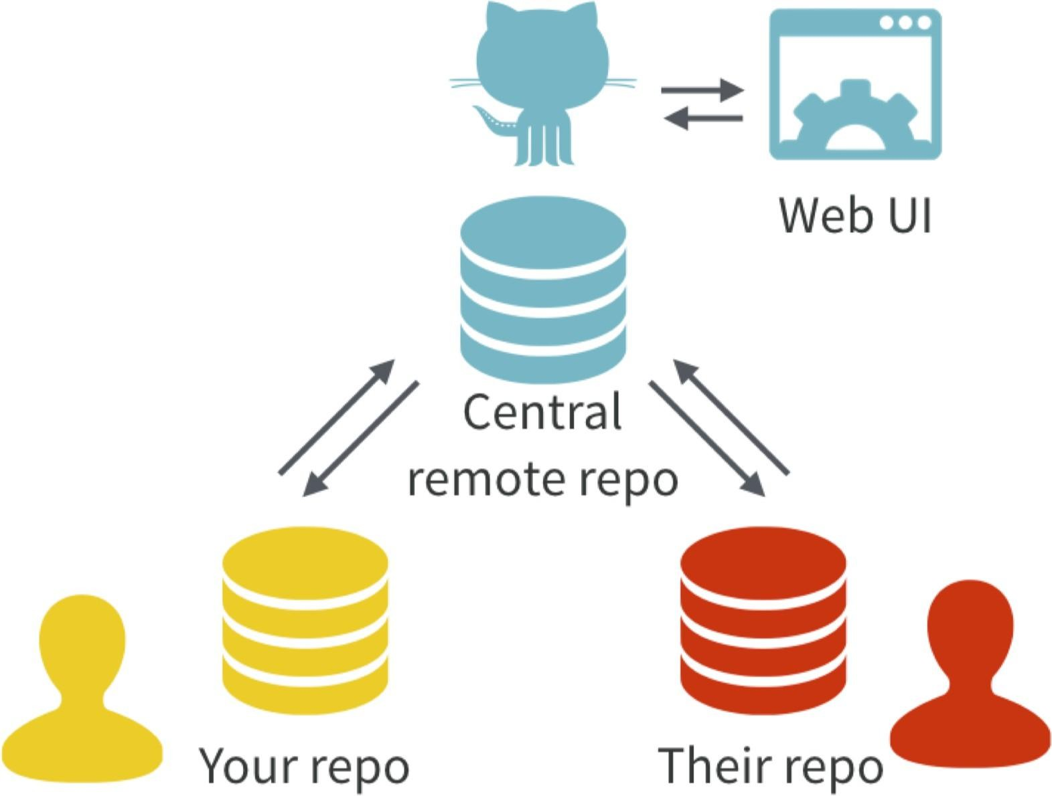
With Git, all contributors have a copy of the repo, with all files and the full history. It is typical to stay in sync through the use of a central remote repo, such as GitHub. Hosted remotes like GitHub also provide access to the repo through a web browser.

Slide 36
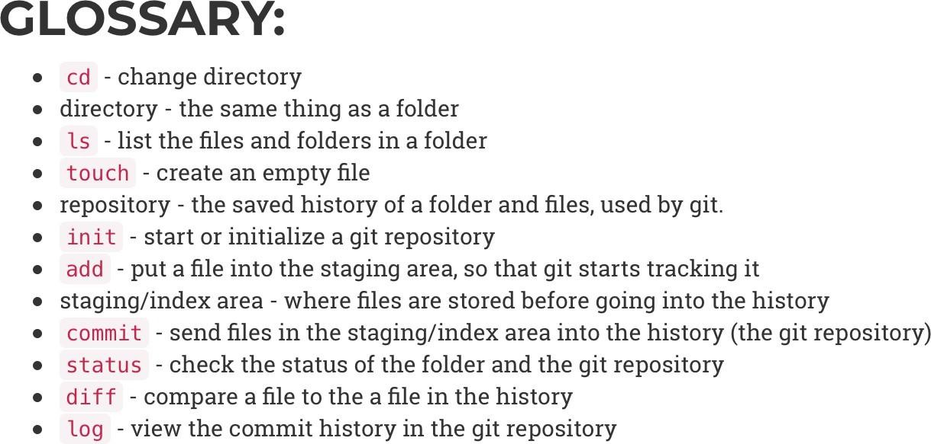
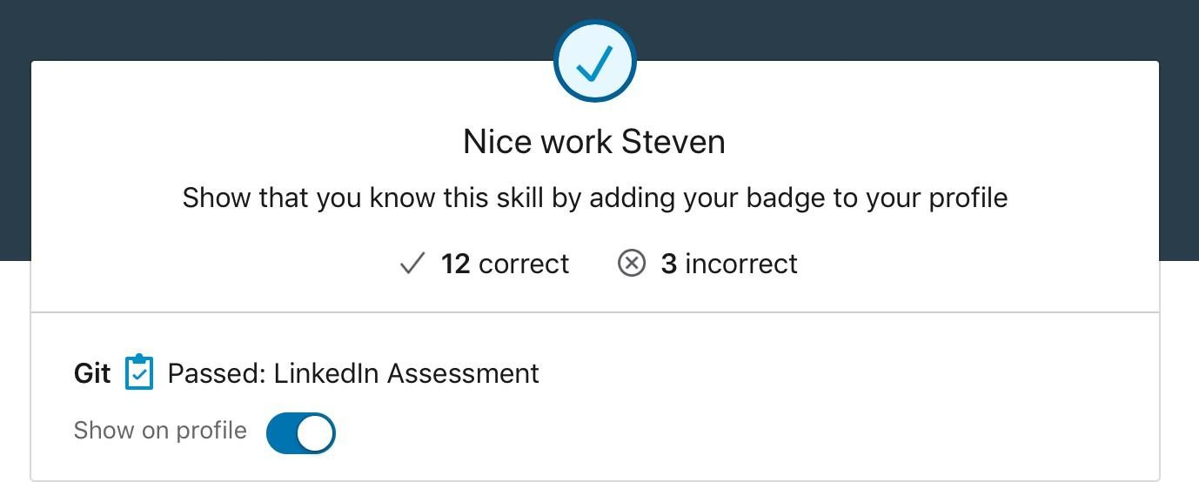
GIT CAN BE COMPLICATED AT FIRST BUT IS EASY TO LEARN
Here are some great places to go to learn Git:
Udemy - Git complete step-by-step guide
TeamTreehouse - Git Basics
Codecademy - Learn Git
Lynda.com - Git Essential Training
atlassian.com - Getting Git Right

Slide 37
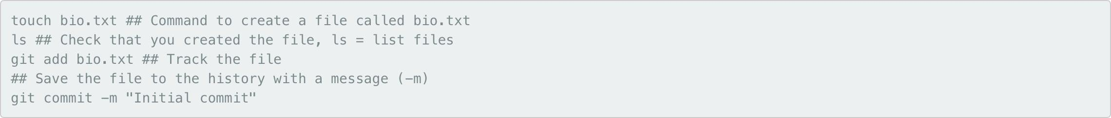
MANY GIT COMMANDS CAN BE EXECTUED WITH GITHUB

Slide 38

HOW DOES GIT WORK: KEY CONCEPTS
Git keeps track of your files using “snapshots” that record what the files in your repository look like at any given point in time
You decide when to take a snapshot and of what files, this is known as a commit
Can be used as noun or verb
“I commited code”
“Ijust made a new commit”
Have the ability to go back and visit any commit
A project is made up of a bunch of commits

Slide 39

KEY CONCEPTS: COMMIT
Commits contain 3 pieces of information:
Information about how the files have changed from the previous commit
A reference to the commit that came before it, known as the parent commit
An SHA-1 hash code (e.g. fb2d2ec5069fc6776c80b3ad6b7cbde3cade4e)

Slide 40
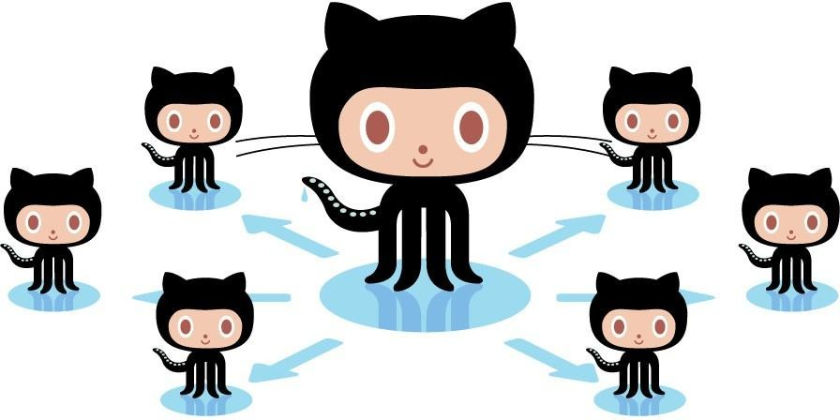
WHAT IS AN
SHA-1 HASH?
SHA-1 is an algorithm and what it does is:
It takes some data as input and generates a unique 40 character string from it.
What does unique mean in this context? Unique means that no other input data should ever produce the same hash. The same input data however should always produce exactly the same hash.
If you and I both look at on our machines
revision f4f78b319c308600eab015a5d6529add21660dc1
and Git tells us that we have a clean working directory, we can be 100% certain that we are looking at exactly the same files.
The hash ensures there is no way someone could manipulate a single bit without Git knowing about it.

Slide 41
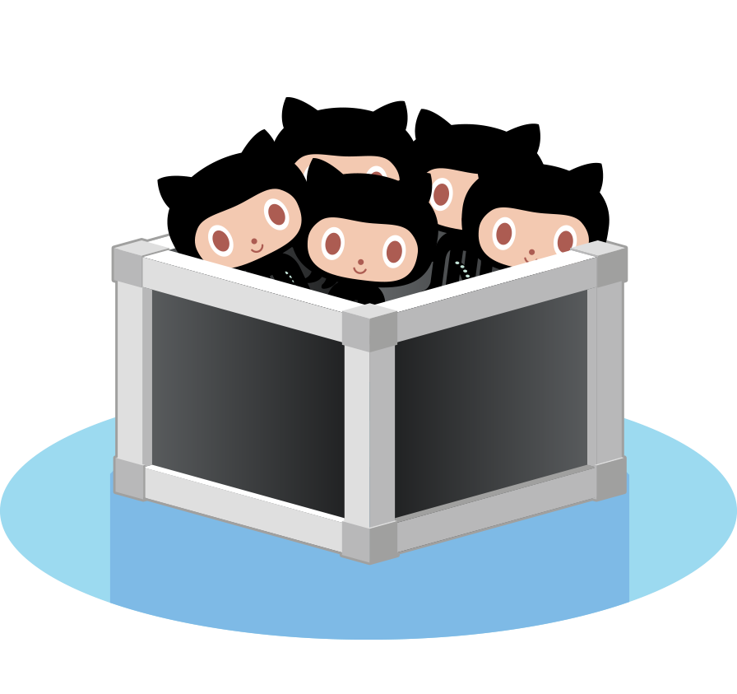
KEY CONCEPTS: REPOSITORIES
Often referred to as a repo, this a collection of all your files and the history of those files (i.e. commits)
Can live on a local machine or on a remote server (e.g. GitHub)
The act of copying a repo from a remote server is called cloning
Cloning from a remote server allows teams to work together
The process of downloading commits that don’t exist on your machine from a remote server is called pulling changes
The process of adding your local changes to a remote repo is called pushing changes

Slide 42
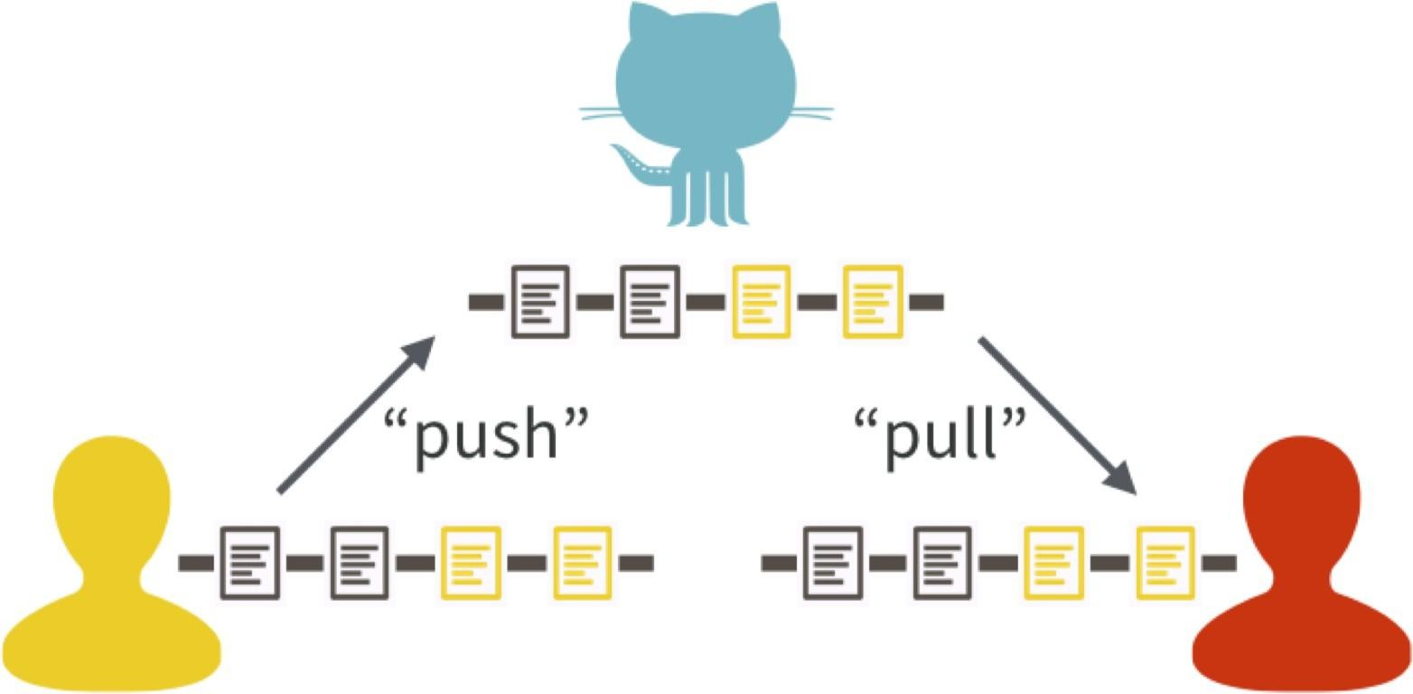
One contributor has made two new commits and updates the master copy on GitHub with a push. Another contributor stays up-to-date with a pull from GitHub.

Slide 43

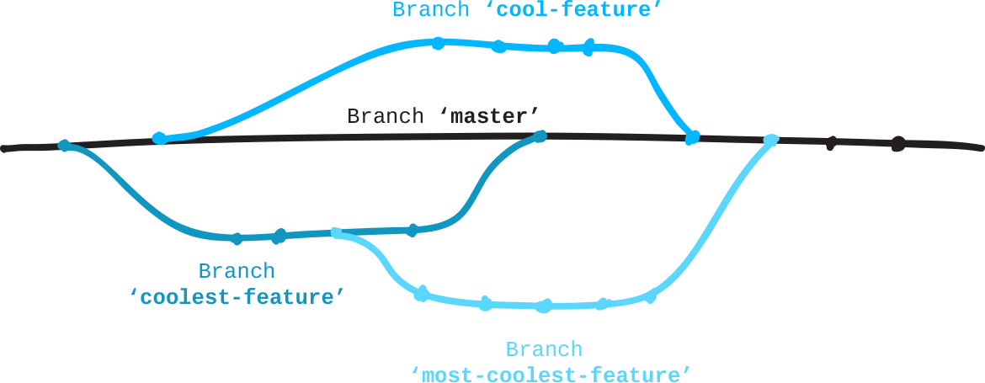
KEY CONCEPTS: BRANCHES
All commits live on a branch
There can be many branches
The project’s main branch is called the master

Slide 44
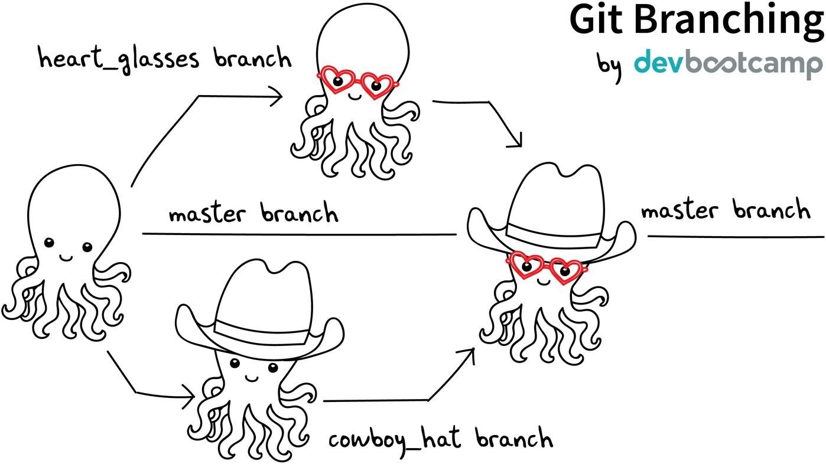

Slide 45

KEY CONCEPTS: README.MD
Collaborate responsibly! Every repository should be initialized
with a file
README.MD
This is where you detail all the information about the project so that the work can be understood and recreated by another student or collaborator
Arguably the most important file in your repo
Use markdown syntax to make your file clear and easy to read

Slide 46
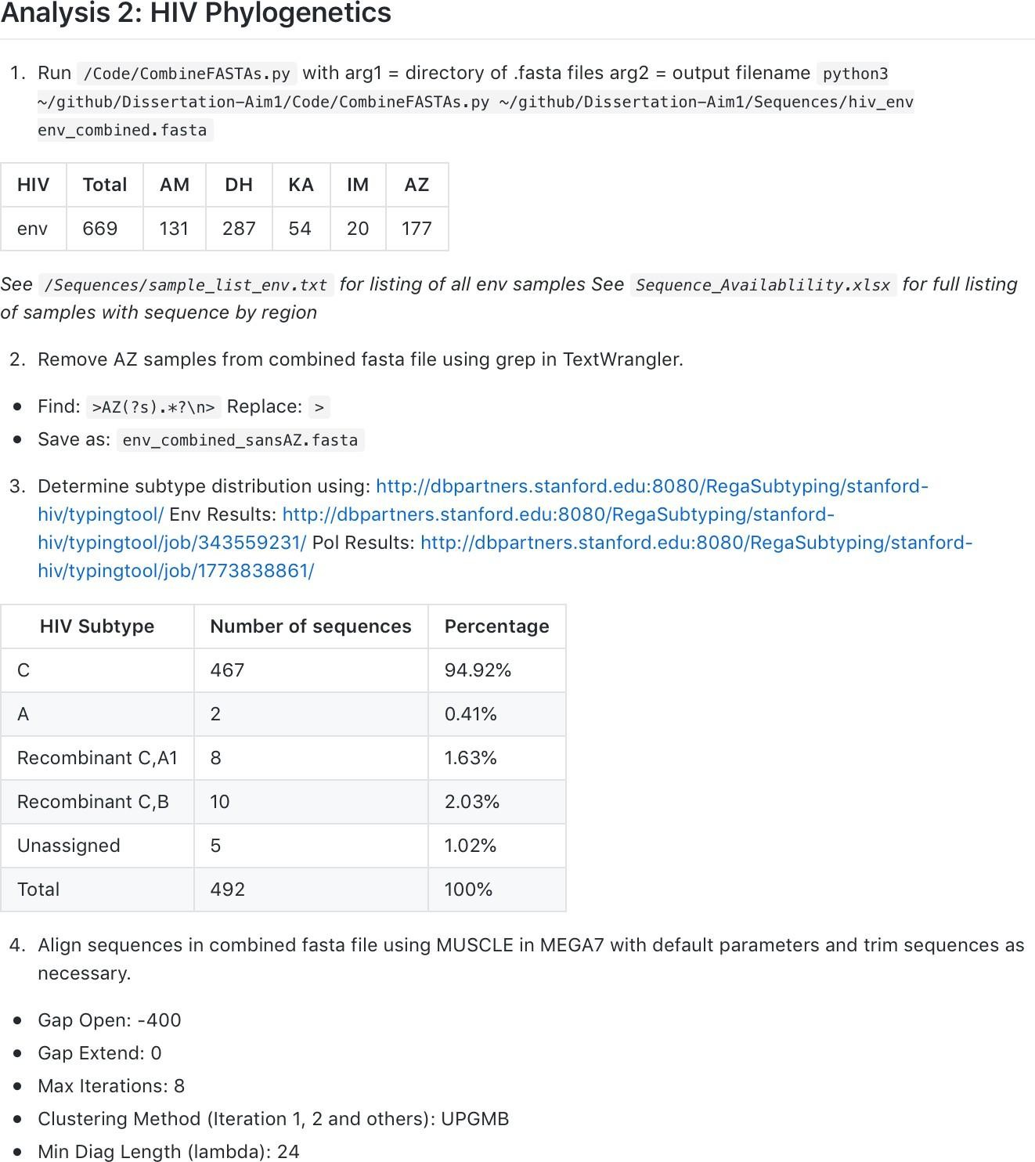
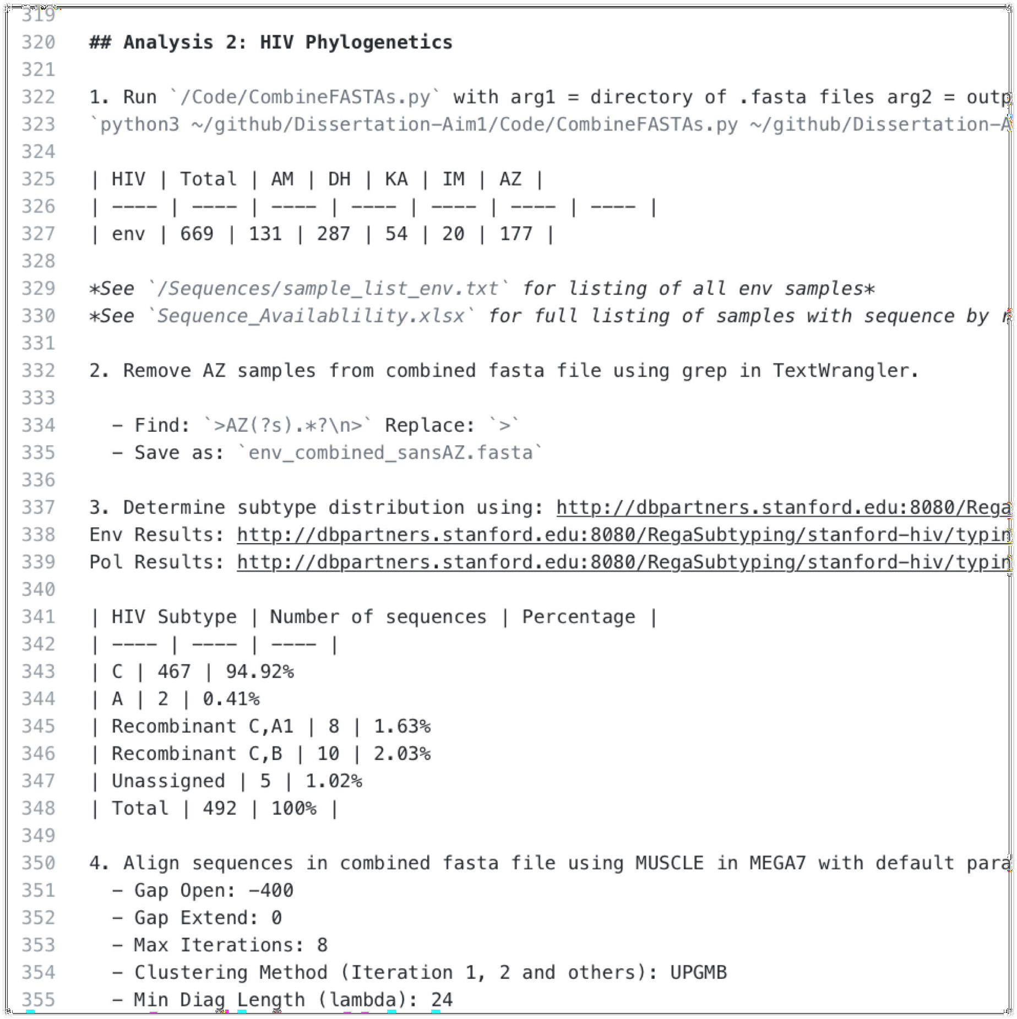

MARKDOWN

Slide 47
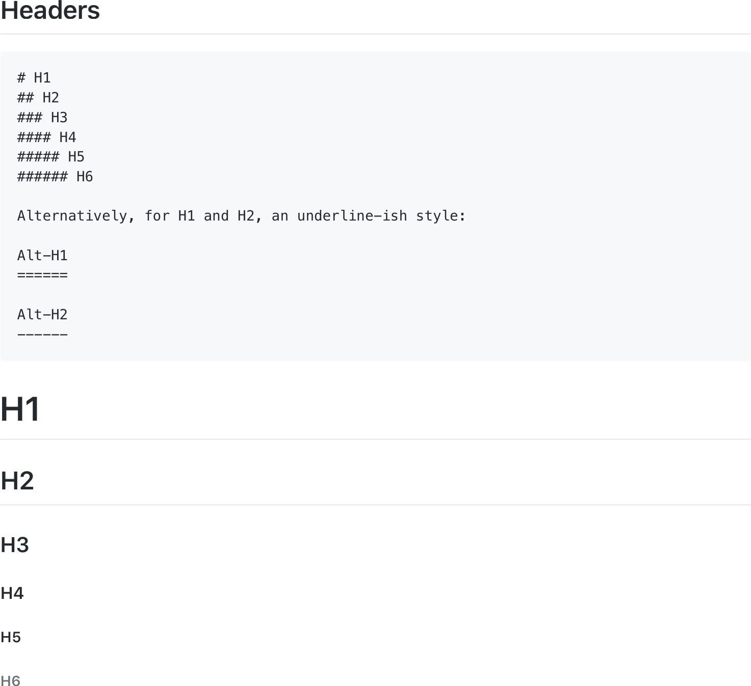
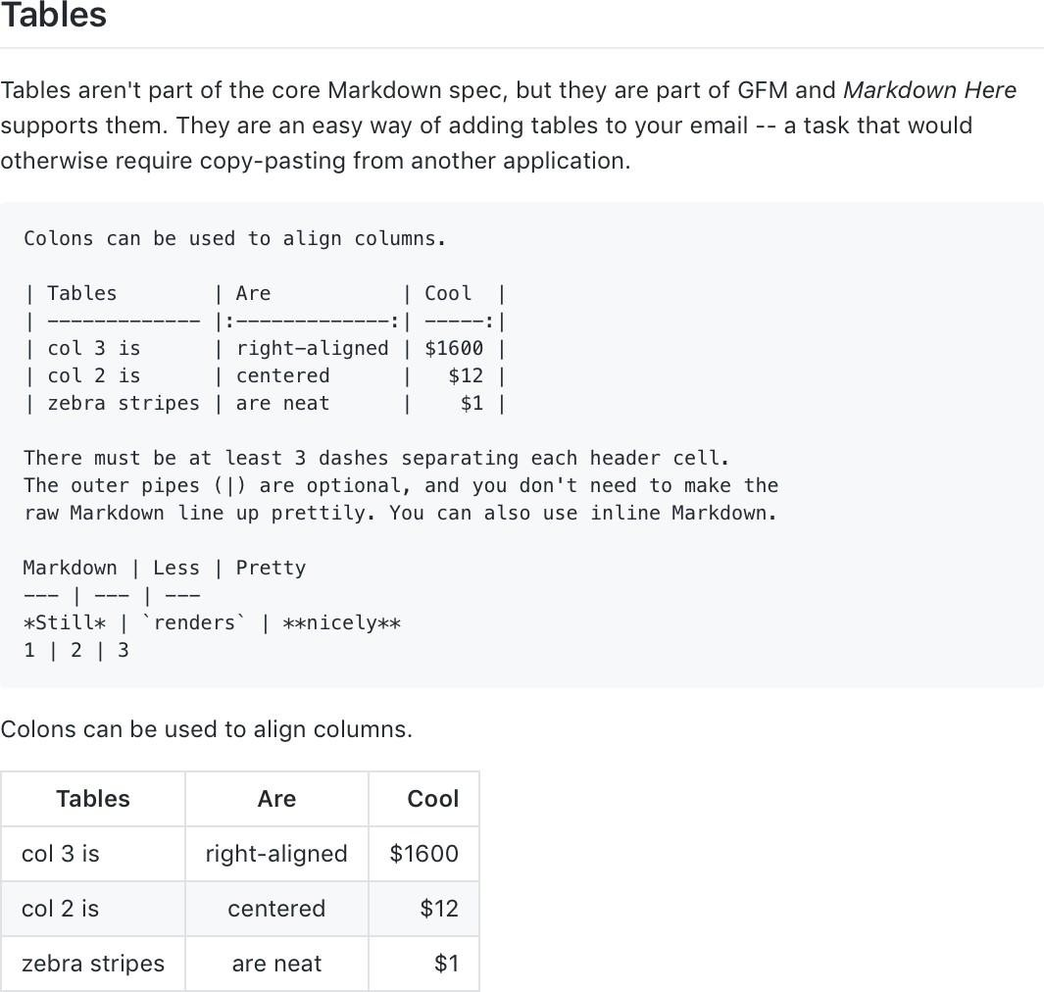
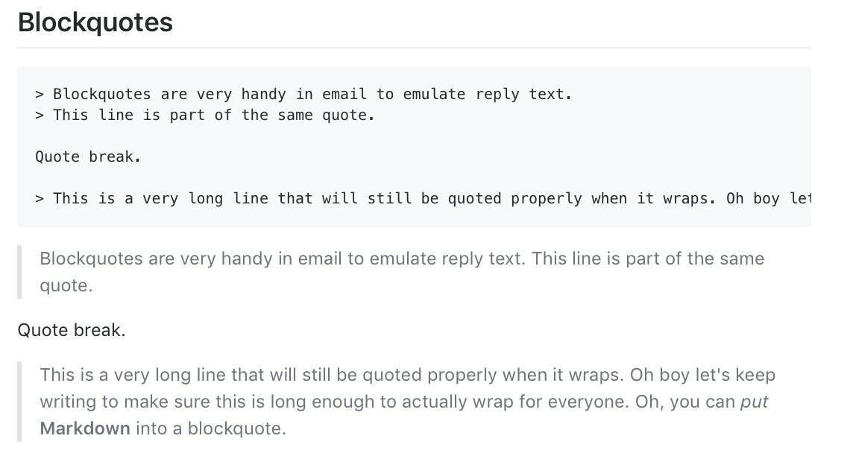
MARKDOWN
Further reading:
github.com/adam-p/markdown-here/wiki/Markdown-Cheatsheet/

Slide 48
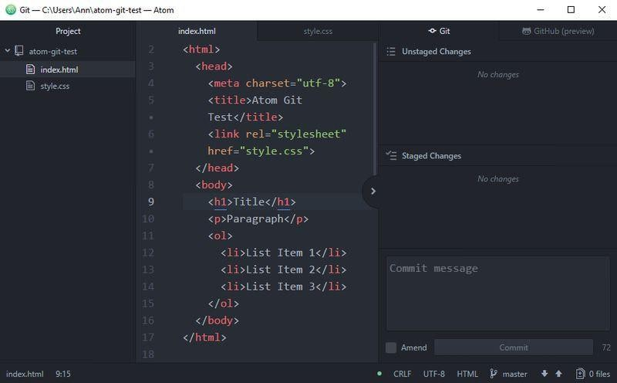


KEY CONCEPS: MAKING A COMMIT
The process:
Make some changes to a file
Use thegit add command or Atom to
add files to the staging area
Type a commit message (that shortly describes the changes you made since the last commit) into the commit message box, and click
the Commit button.

Slide 49
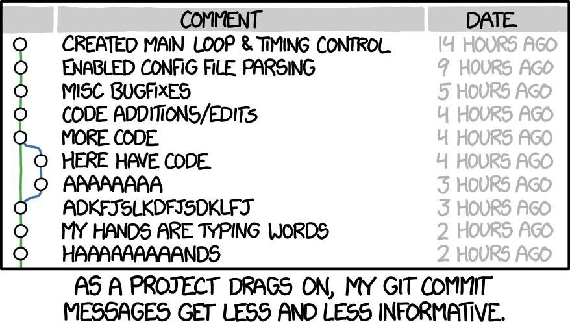
WRITING A GOOD COMMIT MESSAGE
The 7 rules of a great commit message:
Separate subject from body with a blank line
Limit the subject line to 50 characters
Capitalize the subject line
Do not end the subject line with a
period
Use the imperative mood in the subject line
Wrap the body at 72 characters
Use the body to explain what and why vs. how

Slide 50
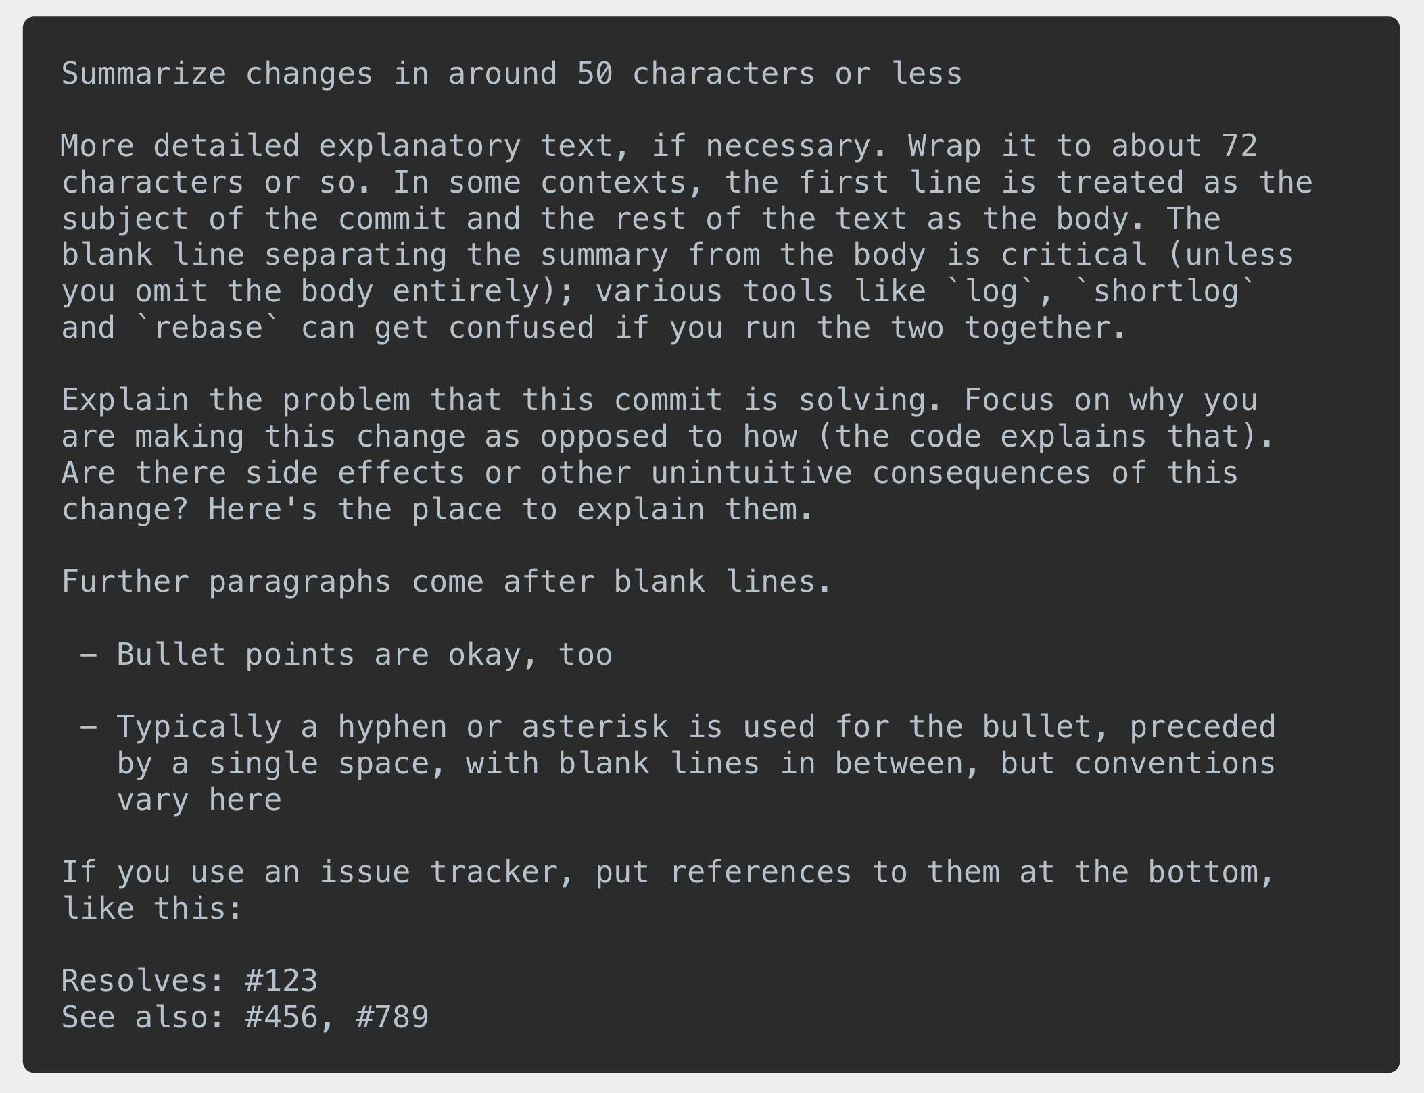

WRITING A GOOD COMMIT MESSAGE
Further reading:
chris.beams.io/posts/git-commit/

Slide 51
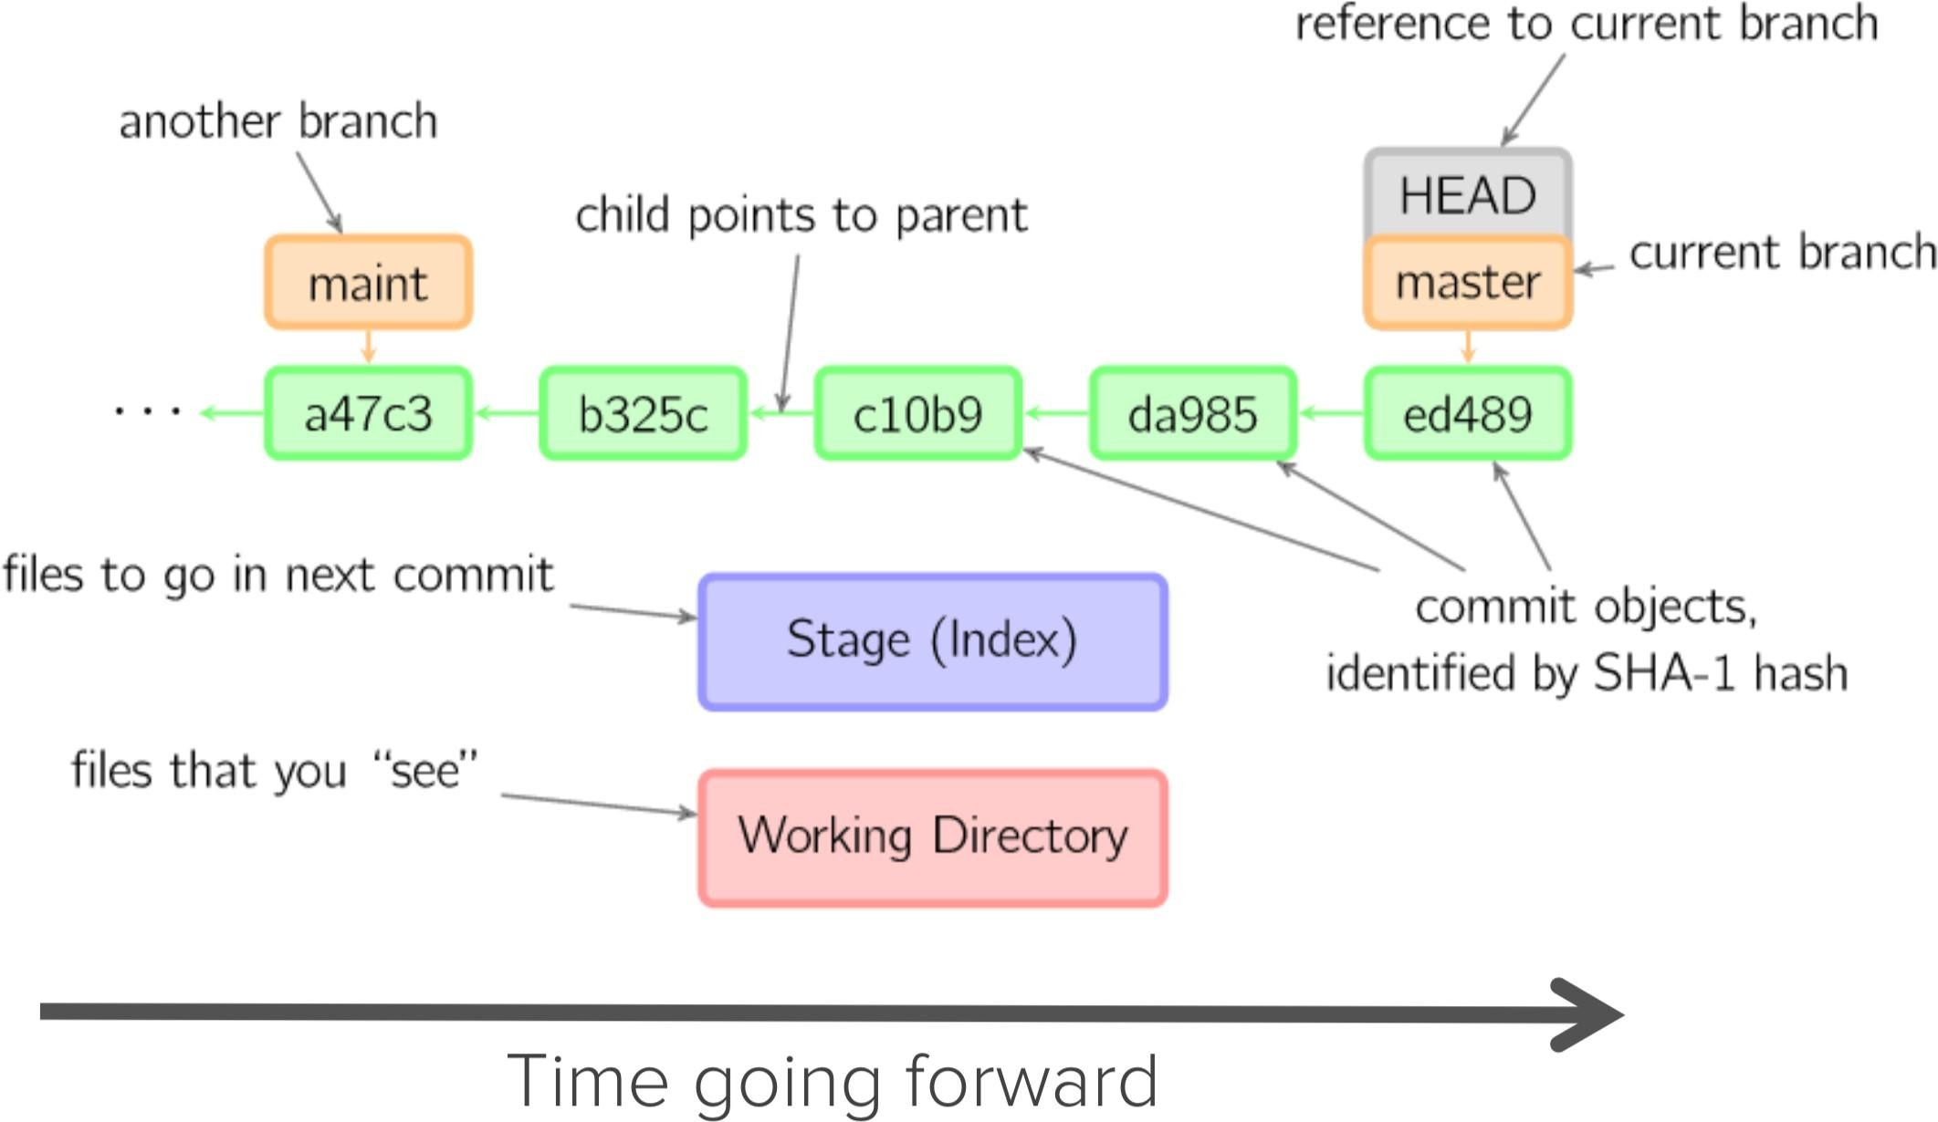

Slide 52
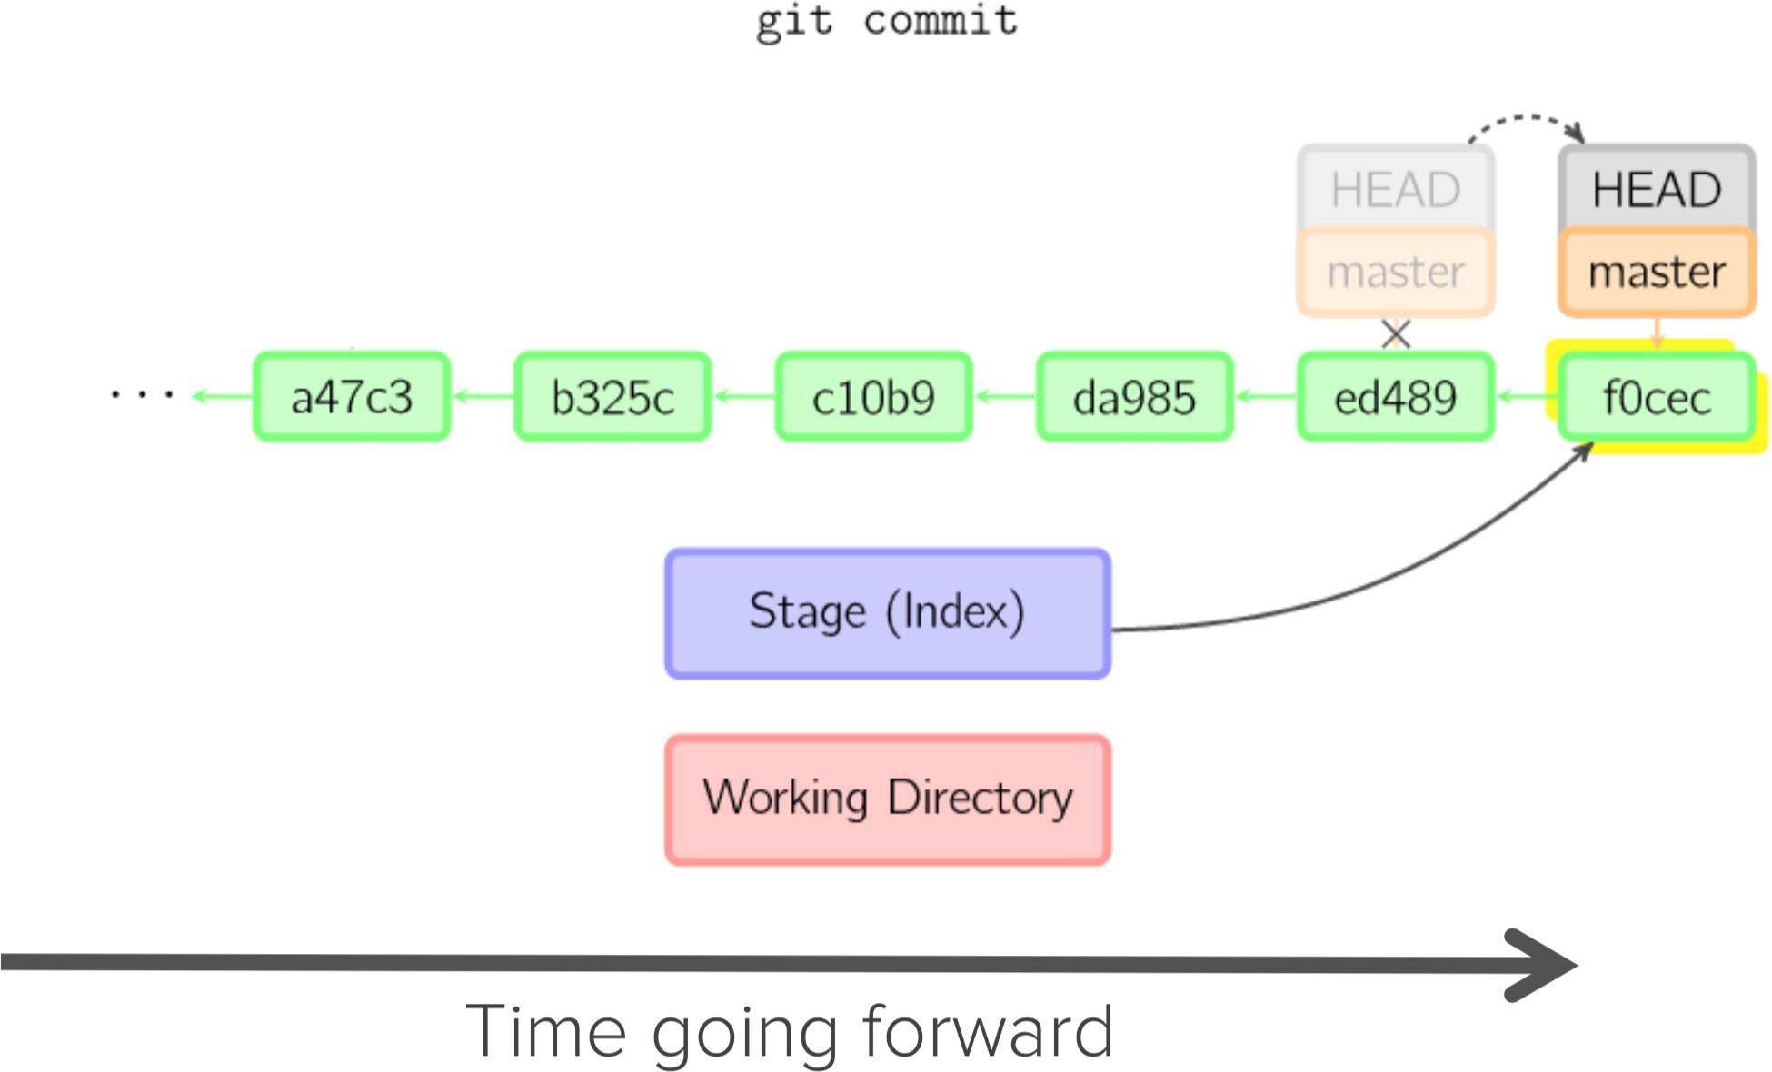

Slide 53
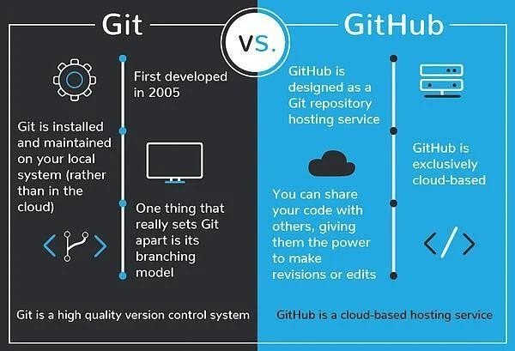

Slide 54
Understanding GitHub Workflow

Slide 55
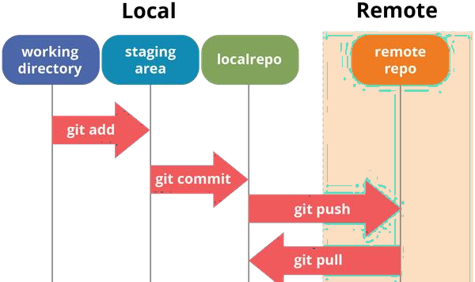

Slide 56

Are you ready?
Let's Git it!

Slide 57
git init
git status
git add - A
git log
git commit - m "message"
git branch feature
git remote add origin [URL]
git checkout feature
git push origin main
Git Commands

Slide 58
ADDITIONAL RESOURCES
Officialgitsiteandtutorial:
https://git-scm.com/
GitHubguides:
https://guides.github.com/
Commandcheatsheet:
https://training.github.com/kit/ downloads/github-git-cheat-sheet.pdf
MardownCheatsheet:
https://github.com/adam-p/markdown-here/wiki/Markdown-Here-Cheatsheet
Interactivegittutorial:
https://try.github.io/levels/1/challenges/1
Visual/interactive cheatsheet:
http://ndpsoftware.com/git-cheatsheet.html

Slide 59

We're done!
If you found this helpful, don't
Repurposing version control software for science represents a transparent, replicable, and streamlined process
forget to follow me on GitHub.
https://github.com/chandanXP
that fosters responsible collaboration

